Slide 1
Research Report
05/24/2024
Yu Li

Slide 2
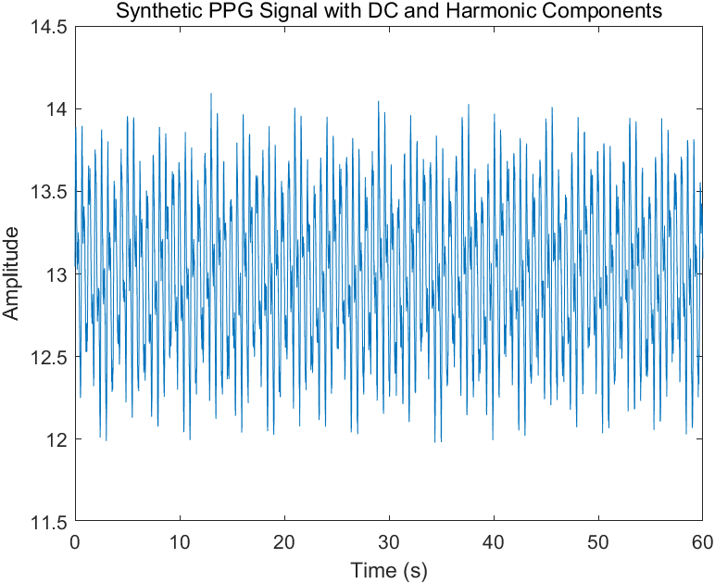
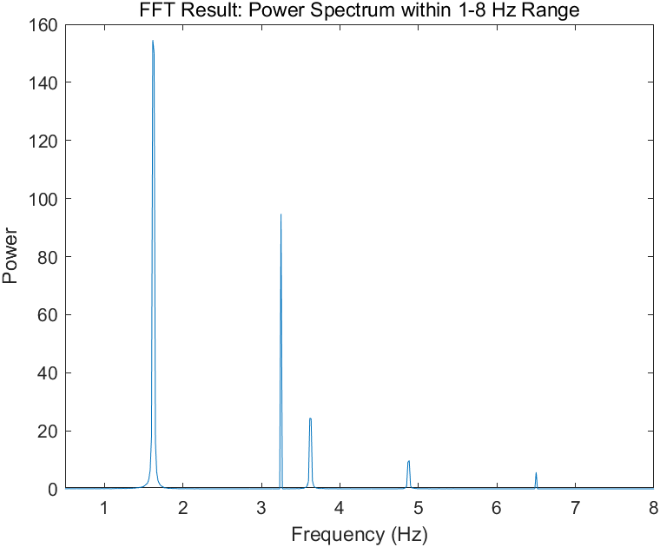
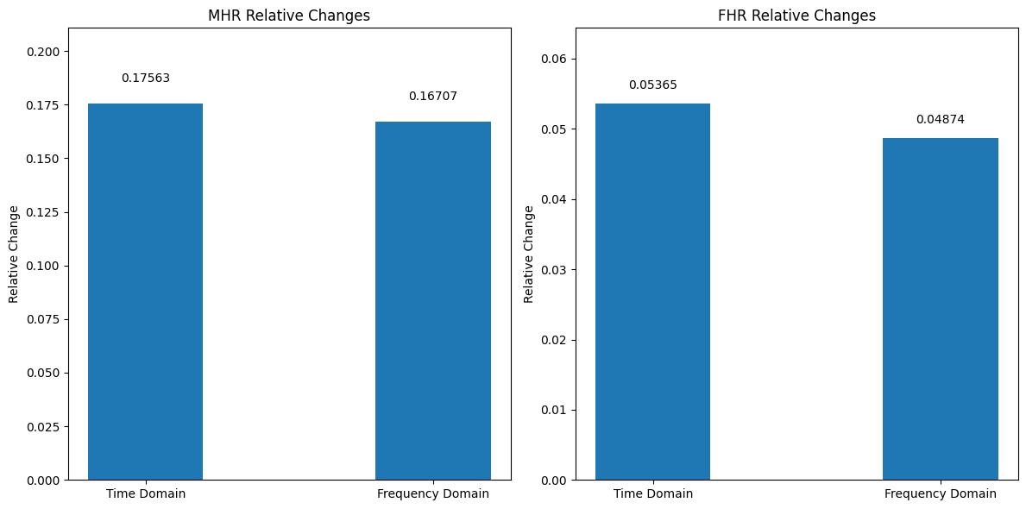
Simple MATLAB signal calculation verification
mhr_signal = 0.5 * sin(2 * pi * mhr_freq * t); % MHR
fhr_signal = 0.2 * sin(2 * pi * fhr_freq * t); % FHR
resp_freq = 0.25; % Respiration frequency
resp_signal = 0.1 * sin(2 * pi * resp_freq * t); % Respiration dc_component = 25*0.5=12.5; % DC component
Calculation Method
PPG time domain signal calculation
(Imax-Imin)/Imin
Power spectrum calculation
Energy of f_MHR /total signal energy

Slide 3
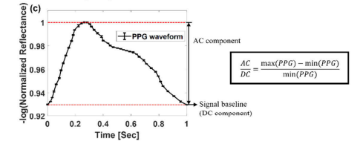
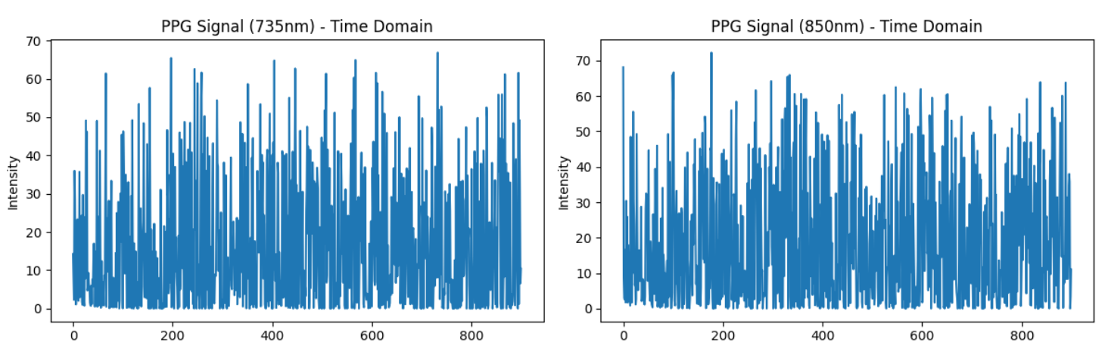
Monte Carlo simulation length data verification 1
Test simulation settings:
N=1000;
alpha_1_init = 0.009
alpha_2_init = 0.01
alpha_3_init = 0.004
alpha_4_init = 0.013
Time domain result (735nm): 4.7429
Frequency domain result (735nm): 0.5057
Time domain result (850nm): 4.0306
Frequency domain result (850nm): 0.5410

Slide 4
Monte Carlo simulation length data verification 2
The Second simulation settings:
N=1000; (for all time)
alpha_1_init = 0.009
alpha_2_init = 0.01
alpha_3_init = 0.004
alpha_4_init = 0.013 ## f(t) is function of time
Target function：
Argmin_Diff_735 = Frequency domain result(735) / Time domain result(735)
Argmin_Diff_735 = Frequency domain result(850) / Time domain result(850)
Result: Optimized absorption coefficient for L1, L2, L4

Slide 5
Monte Carlo simulation length data verification 3
The Third simulation settings:
N=1000*random(0.5,1.5);
alpha_1_init = 0.009*f1(t)
alpha_2_init = 0.01*f2(t)
alpha_3_init = 0.004
alpha_4_init = 0.013*f(t) ## f(t) is fuction of time
Target function：
Argmin_Diff_735 = Frequency domain result(735) / Time domain result(735)
Argmin_Diff_735 = Frequency domain result(850) / Time domain result(850)
Optimized absorption coefficient for L1, L2, L4

Slide 6
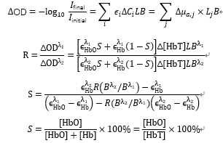
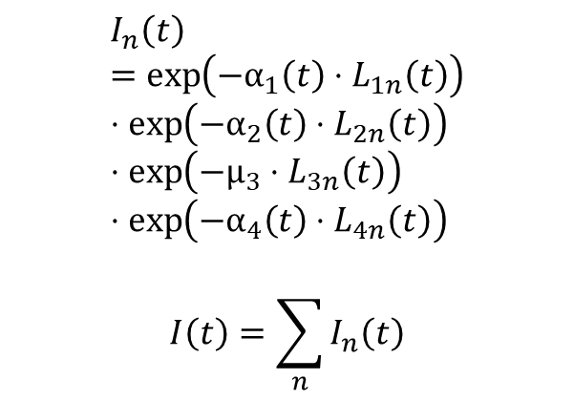
Model flow chart of Monte Carlo simulation
Monte Carlo Simulation L-ppath data
SpO2
μa_(t)
$$I_{n}\left(t\right)=\exp\left(−α_{1}\left(t\right)⋅L_{1n}\left(t\right)\right)⋅\exp\left(−α_{2}\left(t\right)⋅L_{2n}\left(t\right)\right)⋅\exp\left(−μ_{3}⋅L_{3n}\left(t\right)\right)⋅\exp\left(−α_{4}\left(t\right)⋅L_{4n}\left(t\right)\right)$$
$$I\left(t\right)=\sum_{n}{I_{n}\left(t\right)}$$
PPG signal
Preset SpO2 value used to generate PPG signal
Simulation model
SpO2
I(t)
SpO2 values ​​derived from Monte Carlo simulations and calculations

Slide 7
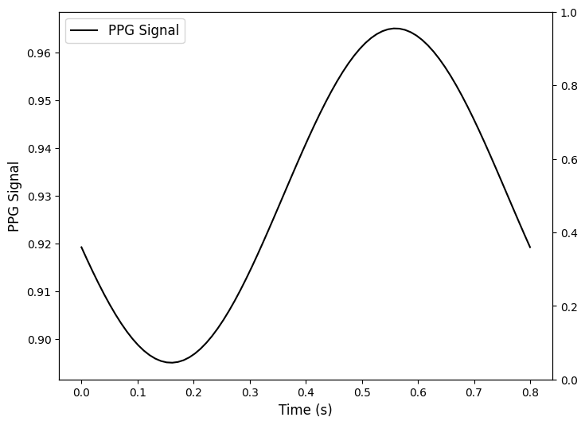
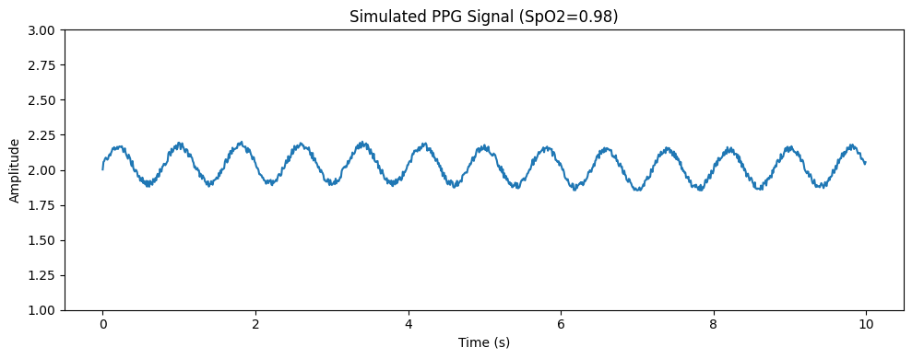
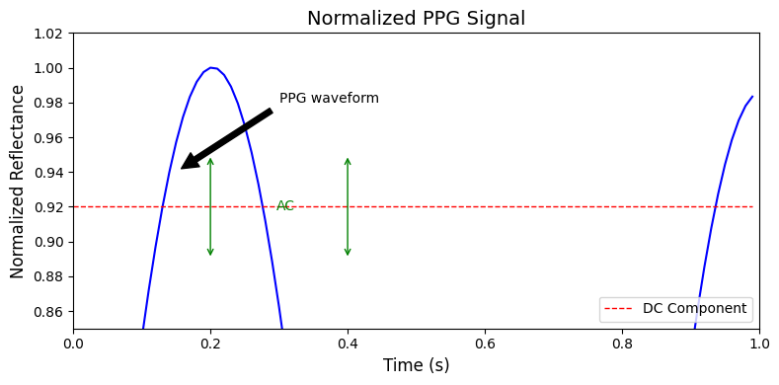
PPG signal simulation
# Set signal parameters
Spo2 = 0.98
hr = 75 # Heart rate
fs = 100 # Sampling frequency of 100 Hz
duration = 10 # Duration of 10 seconds

Slide 8

Intensity calculation combined with Monte Carlo simulation
$$I_{n}\left(t\right)=\exp\left(−α_{1}\left(t\right)⋅L_{1n}\left(t\right)\right)⋅\exp\left(−α_{2}\left(t\right)⋅L_{2n}\left(t\right)\right)⋅\exp\left(−μ_{3}⋅L_{3n}\left(t\right)\right)⋅\exp\left(−α_{4}\left(t\right)⋅L_{4n}\left(t\right)\right)$$
$$I\left(t\right)=\sum_{n}{I_{n}\left(t\right)}$$
N=1000; # Time simulation points
alpha_1_init = 0.009
alpha_2_init = 0.01
alpha_3_init = 0.004
alpha_4_init = 0.013
I_n_735 = np.exp(-alpha_1_735 * L1_735) * np.exp(-alpha_2_735 * L2_735) * np.exp(-mu_3_735 * L3_735) * np.exp(-alpha_4_735 * L4_735)
I_n_850 = np.exp(-alpha_1_850 * L1_850) * np.exp(-alpha_2_850 * L2_850) * np.exp(-mu_3_850 * L3_850) * np.exp(-alpha_4_850 * L4_850)
I_t_735 = np.sum(I_n_735)
I_t_850 = np.sum(I_n_850)

Slide 9
Calculate the SpO2 value using the formula derived previously
In formula calculations, only two point values ​​are available(the peak and valley points).
Simulation and calculation process took about ten rounds of attempts:
The calculated values ​​are collected and the error is about 10%:
[0.8673044 0.99629373 0.88938019 0.85866917 0.99486918 0.8996517 0.9950211 0.85413556 0.94882245 0.85583165]

Slide 10
Calculate the SpO2 value using the formula derived previously
In formula calculations, only two point values ​​are available(the peak and valley points).
Method: 1) By controlling the absorption parameters of layer1 to be fixed, iterate layer2 and layer4.
2) Then repeat the same method for layer2 and layer4 to optimize the simulation calculation.
N=1000; # Time simulation points
alpha_1_init = 0.009
alpha_2_init = 0.01
alpha_3_init = 0.004
alpha_4_init = 0.013
I_n_735 = np.exp(-alpha_1_735)_init * L1_735) * np.exp(-alpha_2_735 * L2_735) * np.exp(-mu_3_735 * L3_735) * np.exp(-alpha_4_735 * L4_735)
I_n_850 = np.exp(-alpha_1_850 * L1_850) * np.exp(-alpha_2_850 * L2_850) * np.exp(-mu_3_850 * L3_850) * np.exp(-alpha_4_850 * L4_850)
I_t_735 = np.sum(I_n_735)
I_t_850 = np.sum(I_n_850)

Slide 11
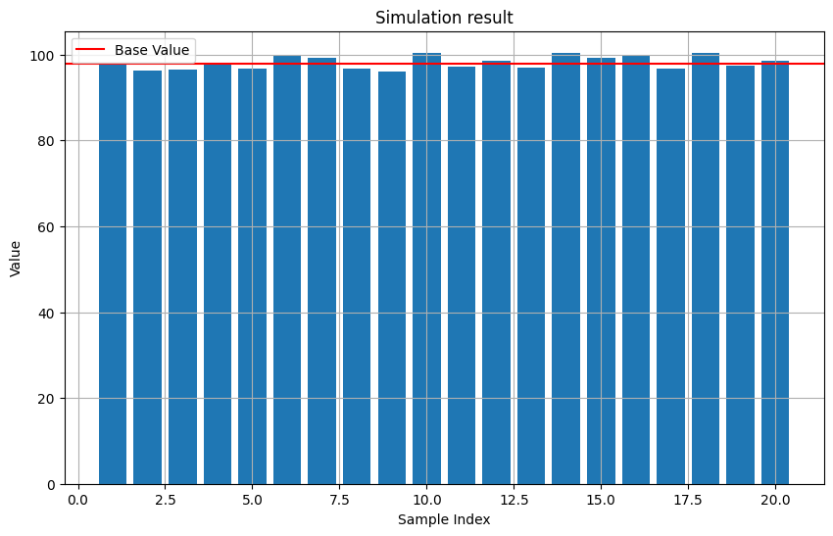
Calculate the SpO2 value using the formula derived previously
In formula calculations, only two point values ​​are available(the peak and valley points).
Simulation and calculation process took about 20 rounds of attempts:
The calculated values ​​are collected and the error is about 3%:

Slide 12
Model flow chart of Monte Carlo simulation
Monte Carlo Simulation L-ppath data
SpO2
μa_(t)
$$I_{n}\left(t\right)=\exp\left(−α_{1}\left(t\right)⋅L_{1n}\left(t\right)\right)⋅\exp\left(−α_{2}\left(t\right)⋅L_{2n}\left(t\right)\right)⋅\exp\left(−μ_{3}⋅L_{3n}\left(t\right)\right)⋅\exp\left(−α_{4}\left(t\right)⋅L_{4n}\left(t\right)\right)$$
$$I\left(t\right)=\sum_{n}{I_{n}\left(t\right)}$$
PPG signal
Preset SpO2 value used to generate PPG signal
Simulation model
SpO2
I(t)
SpO2 values ​​derived from Monte Carlo simulations and calculations

Slide 13
Signal calculation verification
mhr_signal = 0.5 * sin(2 * pi * mhr_freq * t); % MHR
fhr_signal = 0.2 * sin(2 * pi * fhr_freq * t); % FHR
resp_freq = 0.25; % Respiration frequency
resp_signal = 0.1 * sin(2 * pi * resp_freq * t); % Respiration dc_component = 25*0.5=12.5; % DC component

Slide 14
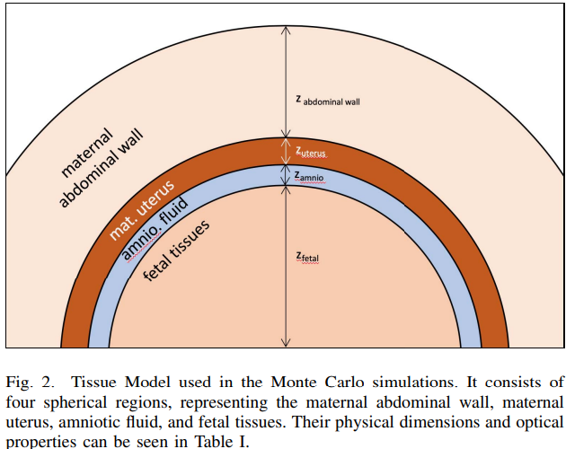
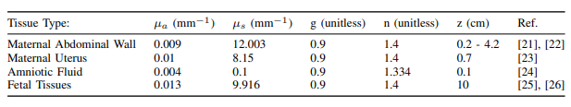
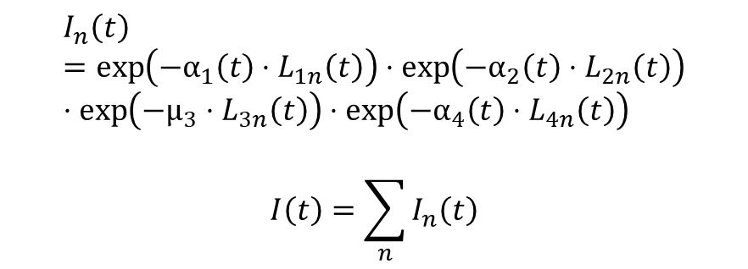
Monte Carlo simulation length data
Reference:
Simulation Construction
$$I_{n}\left(t\right)=\exp\left(−α_{1}\left(t\right)⋅L_{1n}\left(t\right)\right)⋅\exp\left(−α_{2}\left(t\right)⋅L_{2n}\left(t\right)\right)⋅\exp\left(−μ_{3}⋅L_{3n}\left(t\right)\right)⋅\exp\left(−α_{4}\left(t\right)⋅L_{4n}\left(t\right)\right)$$
$$I\left(t\right)=\sum_{n}{I_{n}\left(t\right)}$$

Slide 15
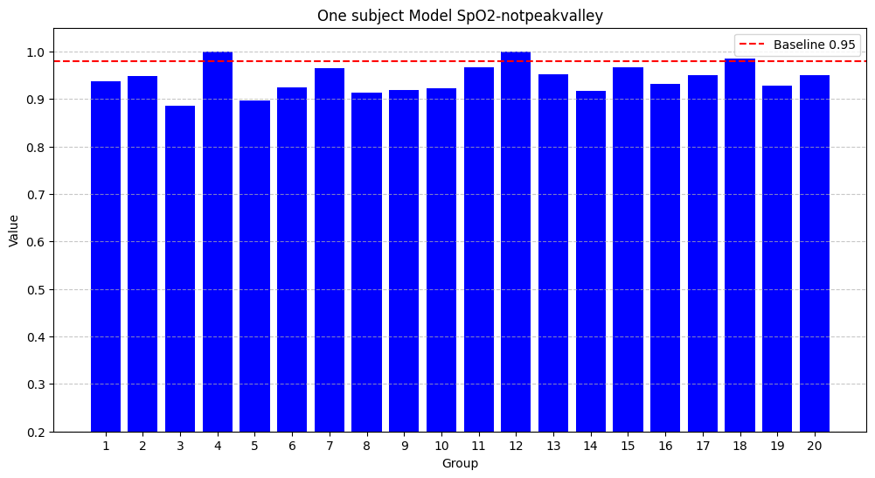
Calculate the SpO2 value using the formula derived previously
In formula calculations, two other points(not the peak and valley) were selected.
After Monte Carlo simulation, the calculations are actually not highly correlated with peak/valley.

Slide 16
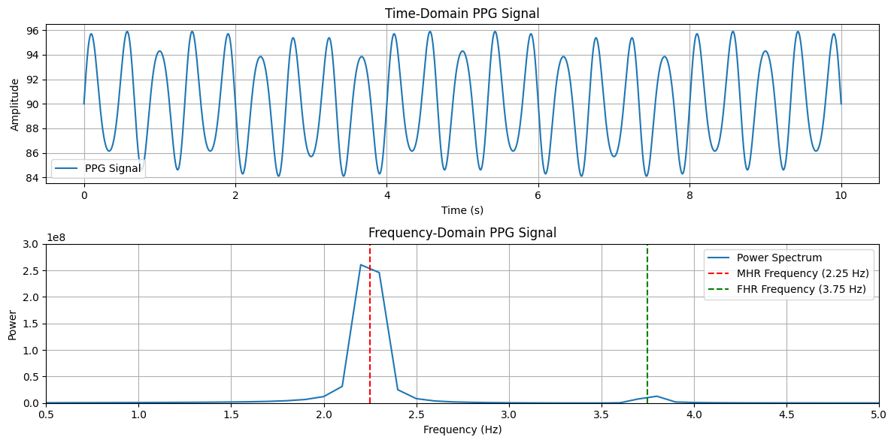
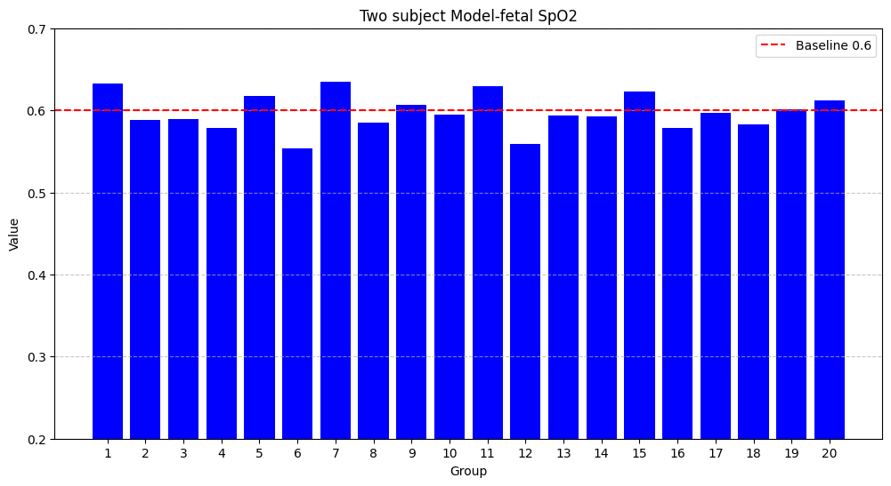
Calculate the SpO2 value in two subjects model
Two PPG signals:
mhr_signal = 5 * sin(2 * pi * mhr_freq * t); % MHR
fhr_signal = 1 * sin(2 * pi * fhr_freq * t); % FHR
resp_signal = 0.4 * sin(2 * pi * resp_freq * t); % Respiration dc_component = 90; % DC component

